Slide 1


Drowsy Detection Using AI

Slide 2

Team Member
Vishvash C
Innodatatics Intern
linkedin.com/in/vishvashofficial

Slide 3

Contents
Business objective
Business Constraints
Project Architecture
Data collection and details
Exploratory Data Analysis
Visualization
Modeling
Evaluation
Deployment
Notes:
Change

Slide 4
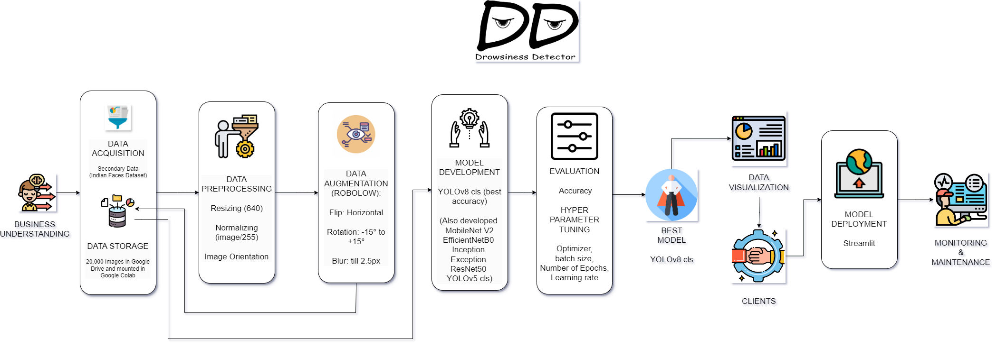
Project Overview and Scope

Slide 5
Business Problem
In the educational context, a significant number of participants occasionally fall asleep while watching lecture videos, resulting in missed concepts.
Consequently, they struggle to identify the exact point where they lost track of the material.
Notes:
Change

Slide 6
Business Objective
Objective
Maximize student engagement and academic performance.
Constraints
Minimize intrusion, maximize privacy
Notes:
Change

Slide 7
CRISP-ML(Q) Methodology
There are six stages of CRISP-ML(Q) Methodology
1.Business and data understanding
2.Data preparation
3.model building
4.Model evaluation
5.Model deployment
6.Monitoring and maintenance

Slide 8
Technical Stacks
Programming Languages: Python
Model Architectures: YOLOv8 cls, MobileNet V2,
EfficientNetB0, Inception, Exception, ResNet50, YOLOv5 cls
Data Storage: Google Drive, Google Colab
Deployment Tools: Streamlit
Notes:
Change

Slide 9
Data Collection and Understanding
Dataset Used: Indian Faces Dataset
Data Points: 20,000 images
Data Source: Kaggle, Roboflow
Purpose: To create a diverse and comprehensive dataset for training the drowsiness detection model

Slide 10
Data Information
Total Images: 20,000
Classes: Drowsy, Active
Image Format: JPEG/PNG
Resolution: Various, resized to 640x640 pixels
Data Augmentation: Performed to increase dataset variability and robustness

Slide 11
Data Dictionary
Image ID: Unique identifier for each image
Image Path: File path to the image location
Label: Indicates whether the person is drowsy or active
Augmentation Type: Type of augmentation applied (flip, rotation, blur)

Slide 12
System Requirements
Hardware:
Processor: Intel Core i5 or higher
RAM: 8 GB or more
GPU: NVIDIA GPU with CUDA support (optional for faster training)
Software:
Operating System: Windows/Linux/MacOS
Python Version: 3.6 or higher
Libraries: TensorFlow, Keras, OpenCV, Streamlit, Roboflow

Slide 13
Exploratory Data Analysis [EDA]
Image Distribution: Number of images per class (drowsy vs. active)
Augmentation Impact: Visualizing how augmentation affects images
Sample Images: Display of sample images from each class
Class Balance: Analysis of class distribution to check for imbalance
Notes:
EDA is used for seeing what the data can tell us before the modeling task.
Change

Slide 14
Missing Values Observation
Data Integrity: Checked for missing or corrupt images
Action Taken: Ensured all images are present and correctly labeled
Outcome: No missing values found

Slide 15
Data Preprocessing
Resizing images to 640x640 pixels
Normalizing pixel values (image/255)
Adjusting image orientation
Tools Used: OpenCV, NumPy
Notes:
Keep observations

Slide 16
Data Visualization
Augmentation Examples: Before and after augmentation images
Sample Images: Randomly selected images from the dataset for visual inspection
Test Images: Test and display new images from both classes
Notes:
Add graphical

Slide 17
Model Building
Model Architectures Tested:
YOLOv8 cls (most successful),
MobileNet V2, EfficientNetB0, Inception, Exception,
ResNet50, YOLOv5 cls
Training Parameters:
Batch Size, Learning Rate
Epochs, Optimization Algorithm
Notes:
classification is the task of predicting a discrete class label. Regression is the task of predicting a continuous quantity.
What is classification techniques in machine learning?
The Classification algorithm is a Supervised Learning technique that is used to identify the category of new observations on the basis of training data. In Classification, a program learns from the given dataset or observations and then classifies new observation into several classes or groups.
What is regression techniques in machine learning?
Regression is a technique for investigating the relationship between independent variables or features and a dependent variable or outcome. It's used as a method for predictive modeling in machine learning, in which an algorithm is used to predict continuous outcomes.

Slide 18
Model Accuracy Comparison
Models Training Accuracy Val Accuracy Test Accuracy
yolov8 cls 95.10 94.70 94.90
MobileNet V2 97.66 91.92 91.31
EfficientNetB0 80.52 80.36 76.78
Inception 79.36 76.79 78.57
Exception 76.88 71.88 71.87
ResNet50 64.53 53.57 59.38

Slide 19
Best Model
Chosen Model: YOLOv8 cls
Accuracy: 95%+
Reason for Selection: Highest accuracy and best performance on
validation set
Notes:
Why Random Forest Regression is good?
A Random Forest Regression model is powerful and accurate. It usually performs great on many problems, including features with non-linear relationships
How is XGBoost different from random forest?
One of the most important differences between XG Boost and Random forest is that the XGBoost always gives more importance to functional space when reducing the cost of a model while Random Forest tries to give more preferences to hyperparameters to optimize the model..
n_estimators — the number of decision trees you will be running in the model

Slide 20
Model Deployment - Strategy
Deployment Platform: Streamlit
Real-time Detection: Integration with web camera feeds
Alert System: Reporting and alerts with timestamps for drowsy detection
User Interface: Simple and interactive UI for monitoring

Slide 21
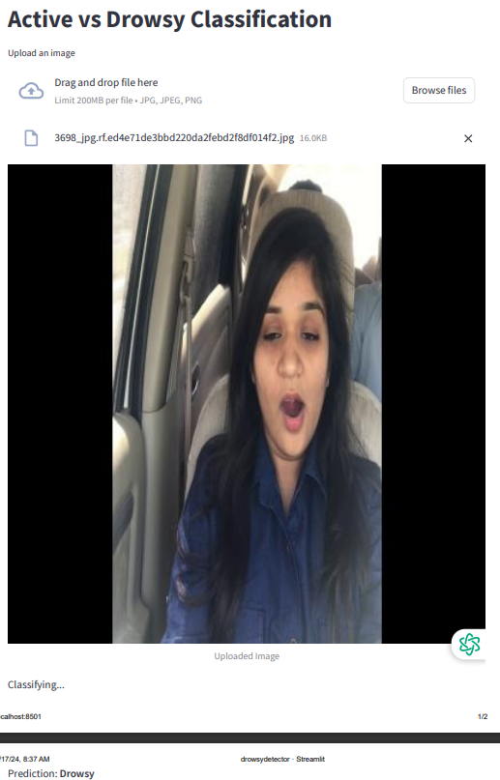
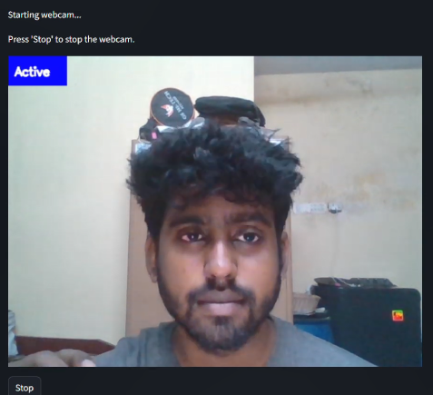
Screen shot of output

Slide 22
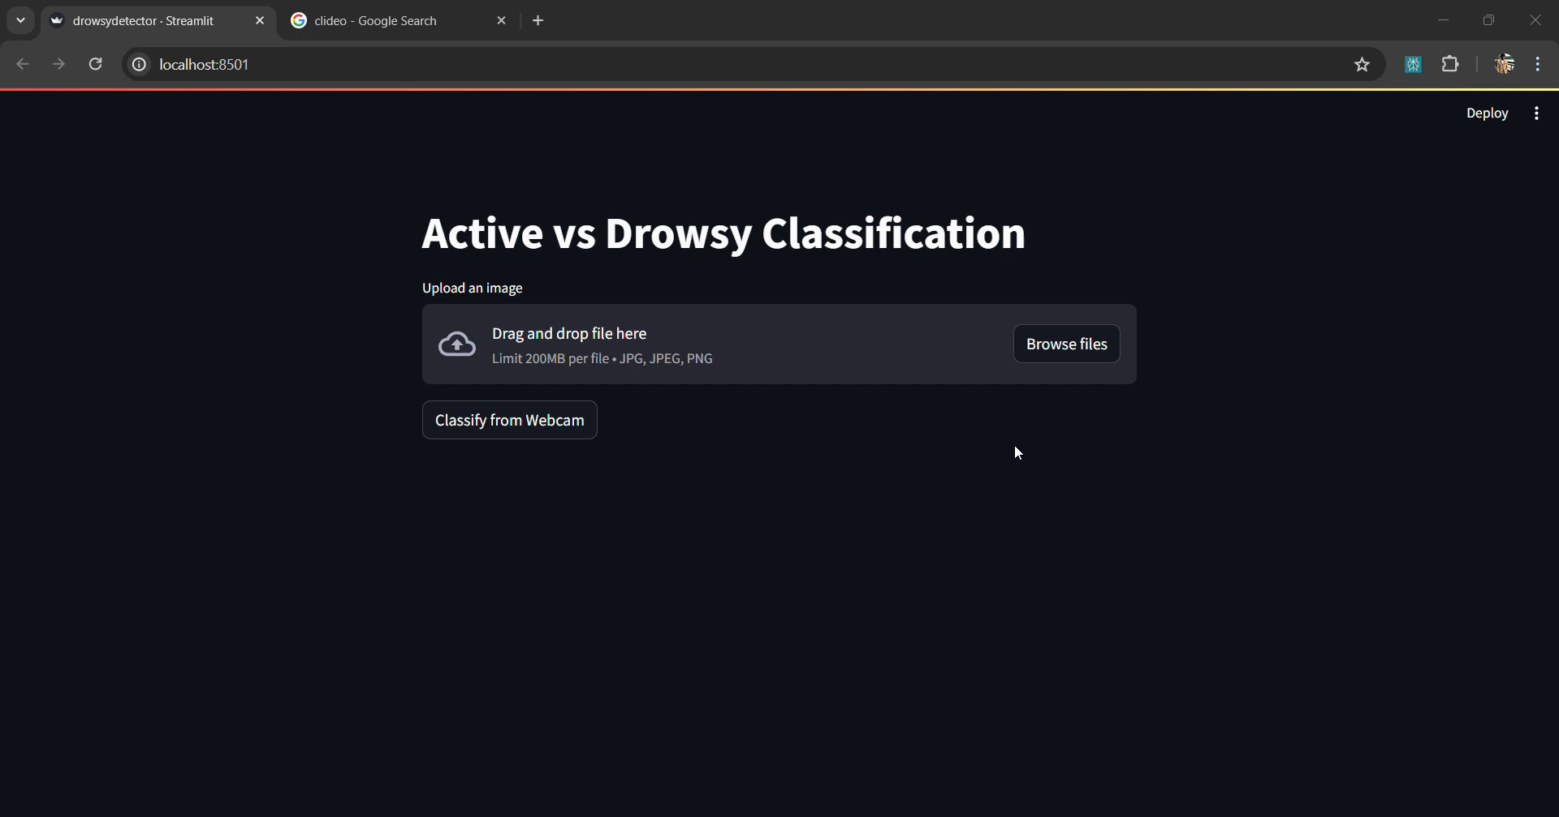
Video of output

Slide 23
Challenges
Data Imbalance: Handling class imbalance in dataset
Real-time Processing: Ensuring real-time detection performance
Model Optimization: Balancing model accuracy and computational efficiency
Deployment: Ensuring smooth and scalable deployment with Streamlit

Slide 24
Future Scopes
Integration with CCTV: Embedding detection system into online learning platforms, and into CCTVs for physical classes
Enhanced Models: Exploring advanced model architectures for improved accuracy
Cross-platform Support: Extending support to mobile and tablet devices
Additional Features: Incorporating more features like interaction rate and blink rate detection

Slide 25
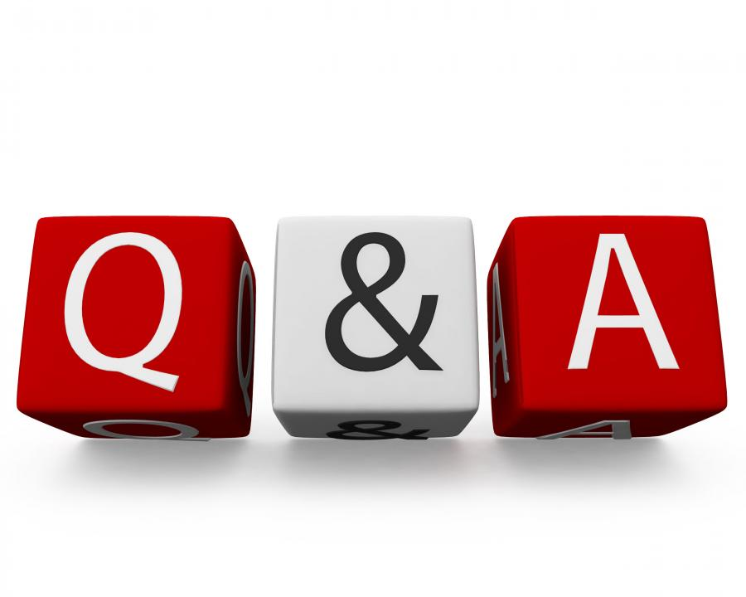
Queries ?

Slide 26


